Slide 1
Reactor/Webflux
11 June

Slide 2
Scope
What is reactive programming?
Non-blocking
Back-pressure
What is the Reactive Streams Specification?
Webflux
Demo App
Testing

Slide 3
What is Reactive Programming
Reactive is used to broadly define event-driven systems
Moves imperative logic to
Asynchronous
Non-blocking
Functional-style code
Allows stable, scalable access to external systems

Slide 4
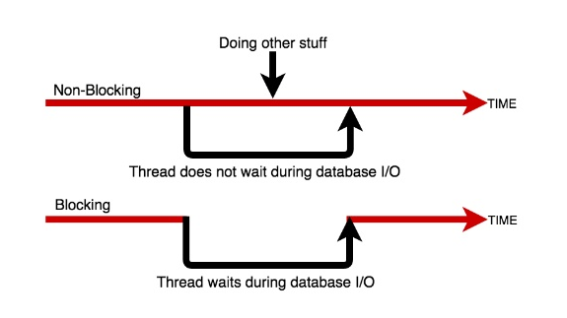
Non-blocking

Slide 5
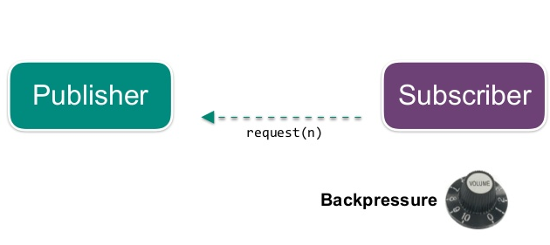
Back-pressure
Allows to control the amount of inflight data
Regulate the transfer between
Slow publisher and fast consumer
Fast publisher and slow consumer

Slide 6
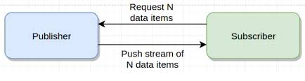
What is the Reactive Streams Specification
Reactive Streams is a protocol for asynchronous stream processing with non-blocking backpressure
De facto standard for interop between reactive libraries
To be included in Java 9 as java.util.concurrent.Flow
Co-designed by Netflix, Lightbend, Pivotal, RedHat, Kaazing, Twitter and many others

Slide 7
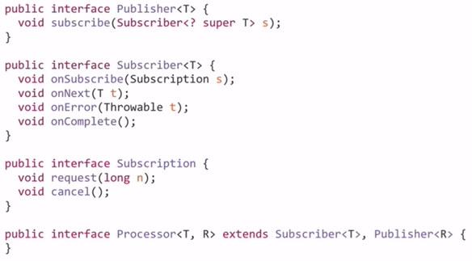
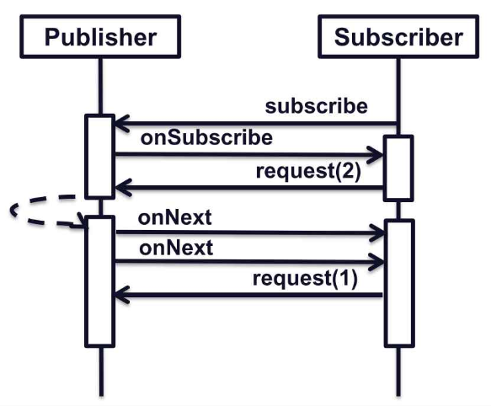
Reactive Streams API

Slide 8
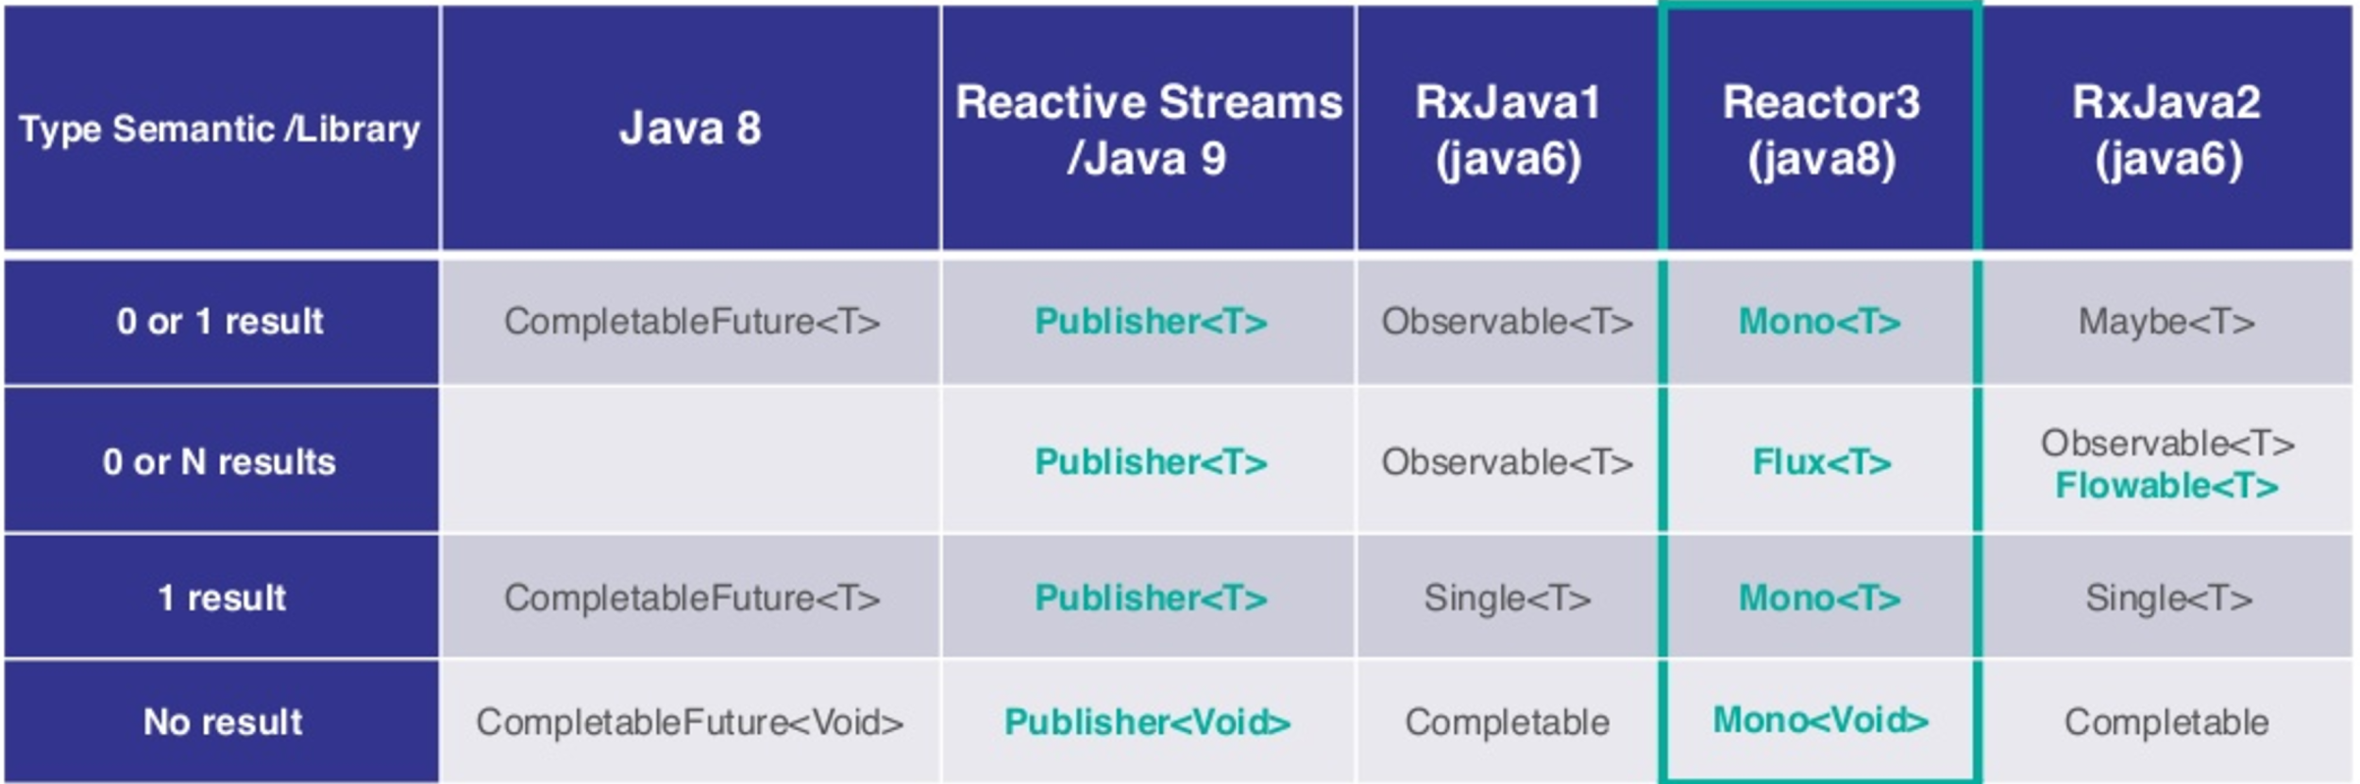
Reactive APIs on JVM

Slide 9
Reactor
Reactor - implementation of reactive streams
Lightweight, functional API with 2 types: Mono and Flux
Native Java 8 support (lambdas)
Single 1 Mbytes JAR
Reactive foundation of Spring Framework 5
Provides a number of out-of-the-box integration libraries for various network services like Kafka and Netty

Slide 10
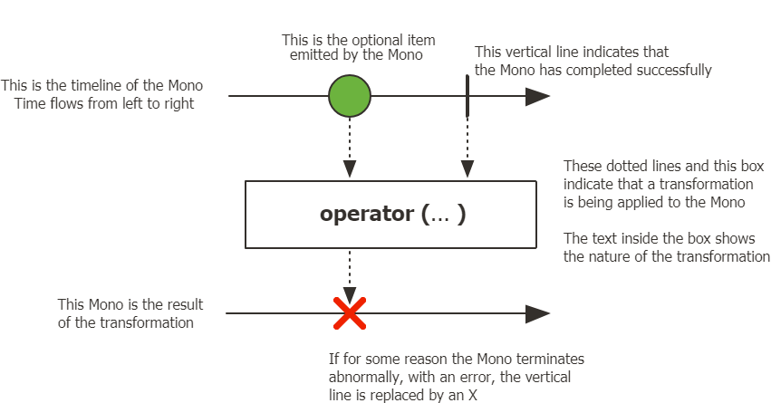
Mono
Implements Reactive Streams Publisher
0 to 1 elements
Operators mono.map(...).zip(...).flatMap(...).subscribe(...)

Slide 11
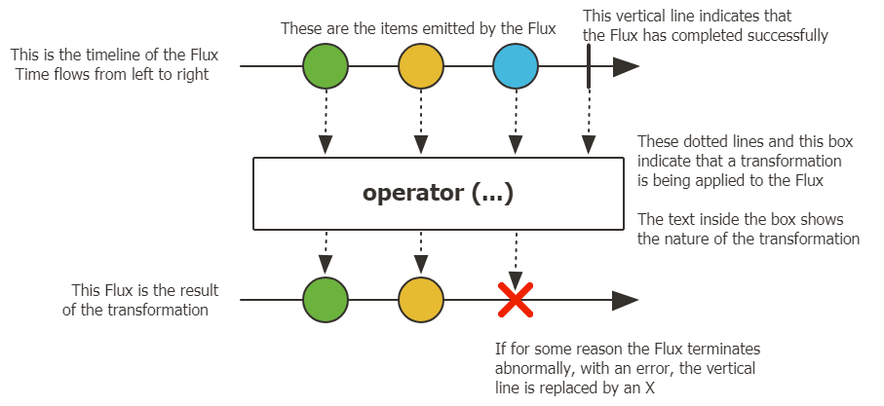
Flux
Implements Reactive Streams Publisher
0 to n elements
Operators flux.map(...).zip(...).flatMap(...).subscribe(...)

Slide 12
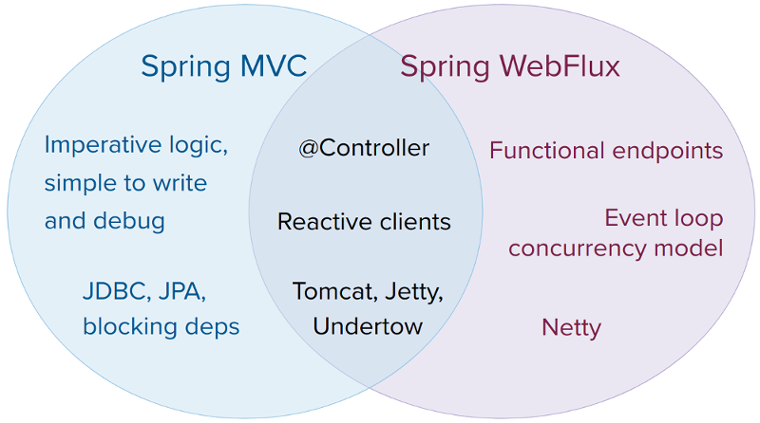
What is Webflux?
Pivotal/Spring implementation of HTTP services
It’s non-blocking and supports Reactor types.
Offers two methods of exposing RESTful services
Functionally defined handlers - WebfluxFn
Annotated controllers

Slide 13
What is WebClient?
Non-blocking reactive client for performing HTTP requests
Provides functional API that takes advantage of Java 8 lambdas
By default uses Reactor Netty as the HTTP client library
To start using you have to include Webflux as your project dependency

Slide 14
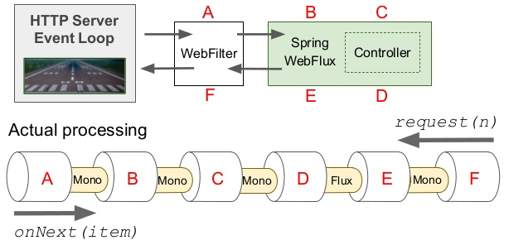
Reactive web stack

Slide 15
Demo
Spring MVC examples
Blocking and non-blocking data repository
Number of threads, cpu and memory usage
Spring Webflux controller
Blocking, non-blocking data repository
Compare with previous version
Spring Webflux functional api
Blocking, non-blocking data repository
Compare with previous version
Hot/Cold Flux??
Testing?

Slide 16
Demo Results
Github: https://github.com/dancohensmith/spring-reactive-streams
MvcApplication -Xmx16m
WebfluxApplication -Xmx16m
 | Endpoint | Memory | Requests/s
MVC | localhost:8082/mvc/nonBlocking/{delay} | 16MB | 45
Webflux | localhost:8083/fn/nonBlocking/{delay} | 16MB | 450

Slide 17
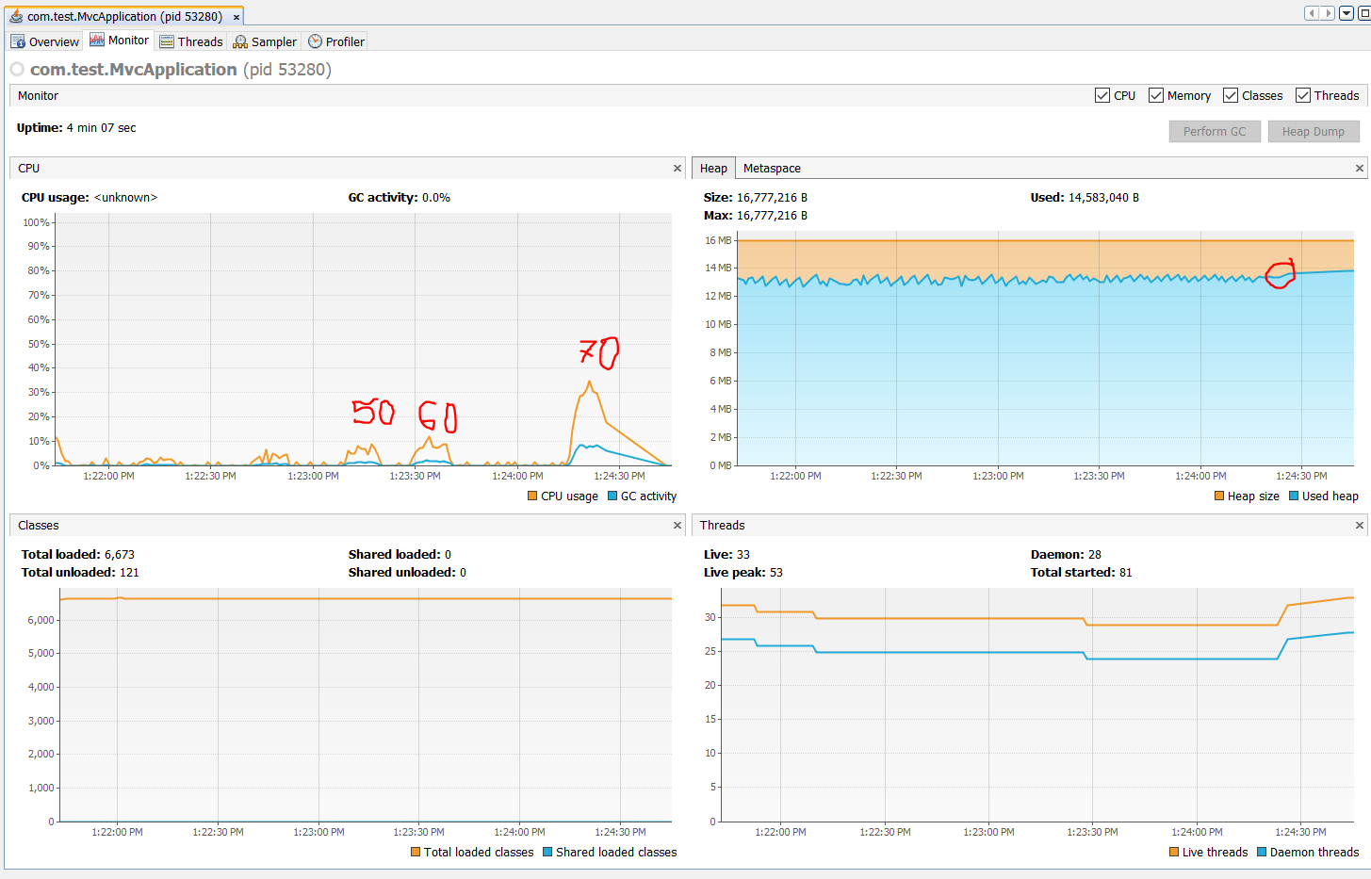
Demo Results - MvcApplication

Slide 18
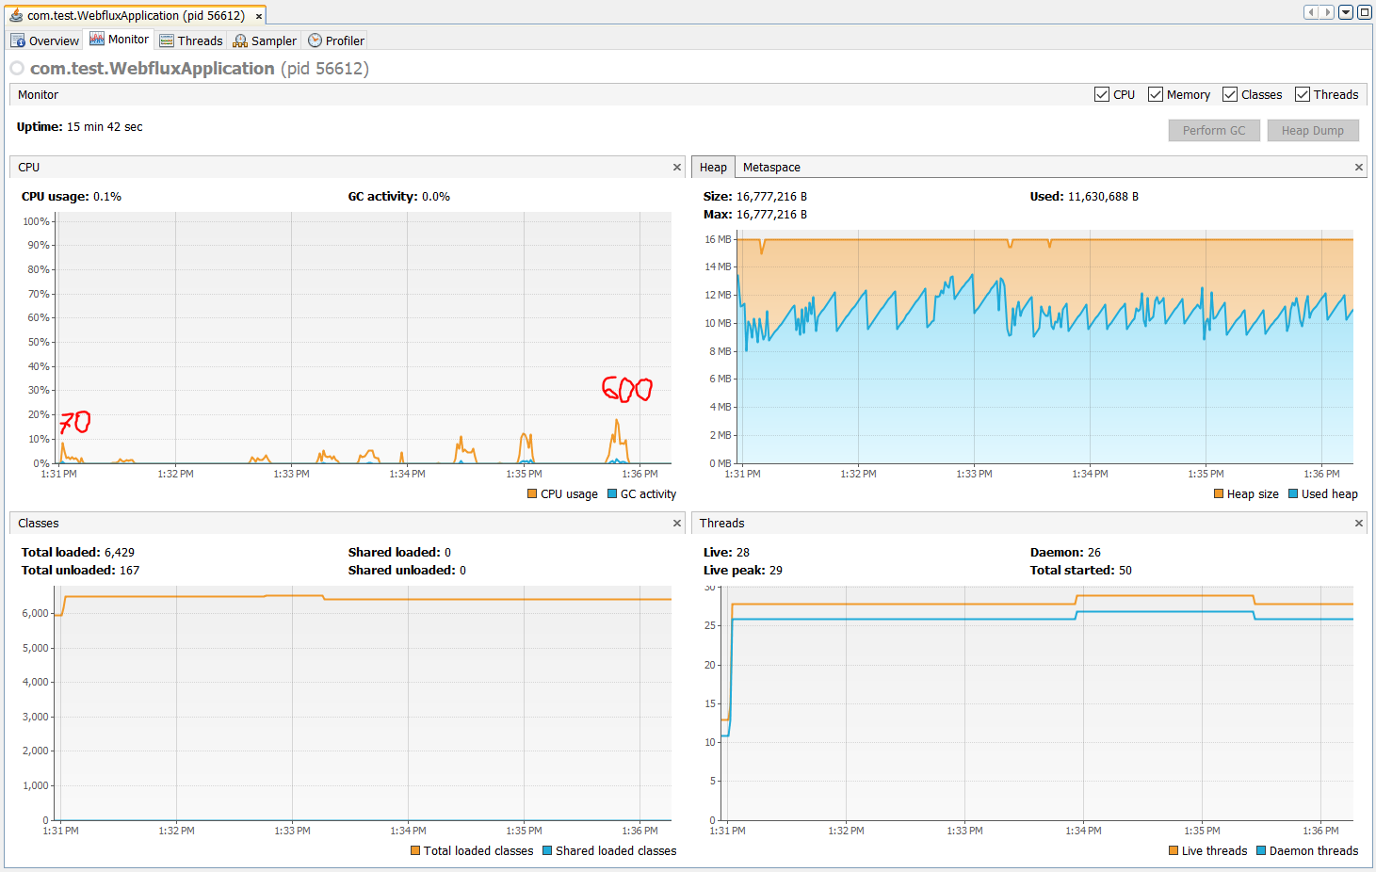
Demo Results - WebfluxApplication

Slide 19
References
https://www.infoq.com/news/2017/12/servlet-reactive-stack
https://www.infoq.com/presentations/servlet-reactive-stack
https://www.infoq.com/articles/Servlet-and-Reactive-Stacks-Spring-Framework-5
https://www.infoq.com/presentations/spring-reactive-webflux
https://www.reactive-streams.org/

